Slide 1
Framework and Data Model for OTN Network Slicing
draft-zheng-ccamp-yang-otn-slicing-01
Co-authors:
Haomian Zheng (Huawei)
Italo Busi (Huawei) Aihua Guo (Futurewei)
Victor Lopez(Telefonica)
Contributors:
Henry Yu (Huawei)

Slide 2
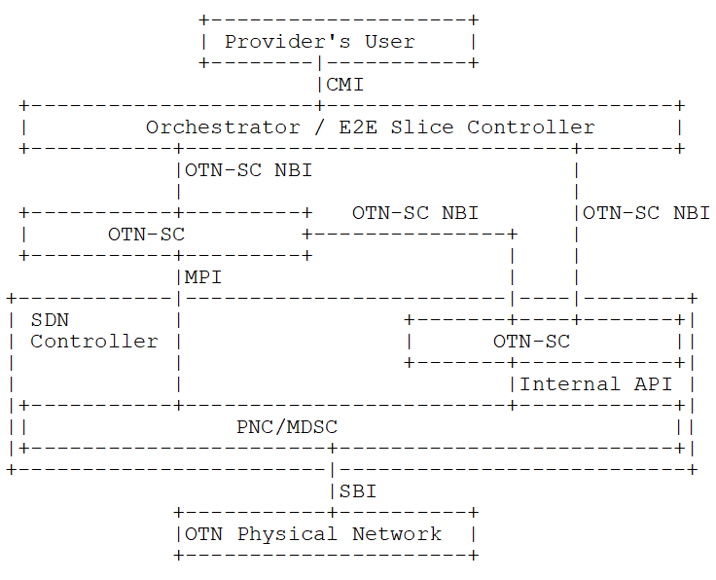
OTN Slicing Interfaces
OTN slice controller (OTN-SC) may be deployed either outside or within an SDN controller
Translating slice configuration into OTN TE topology or TE tunnel requests at the MPI, or
Interact with higher- or lower-level slice controller in a recursive manner
Interaction between OTN-SC and IETF network slice controller is for further study
An IETF network slice controller may use an OTN-SC to provision OTN slices to support end-to-end slicing

Slide 3
OTN Slicing Realization @ MPI
Connectivity-based
An OTN slice is realized by creating client services over ODU switched TE tunnels.
This case is already covered by existing YANG model clusters:
Network topology/generic TE topology/OTN TE topology
Generic TE tunnel/OTN TE tunnel
Client signal
Resource-based
Realizing an OTN slice by reserving ODU topological resources
This is the focus of the YANG model proposed in this draft

Slide 4
Major Updates since IETF 109
Added co-authors
Updated use case description
Leased Line Services with OTN
Co-construction and Sharing
Wholesale of optical resources
Vertical dedicated network with OTN
Added YANG data model for OTN-SC MPI
OTN slice realization with ODU resource coloring over TE topology
Link- or time slot-based
ODU resource reservation is performed by the underlying PNC/MDSC

Slide 5
YANG Model @ MPI
module: ietf-otn-slice
augment /nw:networks/nw:network/nt:link/tet:te/tet:te-link-attributes:
+--rw (otn-slice-granularity)?
+--:(link)
| +--rw slice-id? uint32
+--:(link-resource)
+--rw slices* [slice-id]
+--rw slice-id uint32
+--rw (technology)?
| +--:(otn)
| +--rw otn-ts-num? uint32
+--ro sliced-link-ref? -> ../../../../../nt:link/link-id
* A prior version of this YANG model was contributed to ONAP and is included in its Guilin Release.

Slide 6
Next Steps
Add YANG data model for OTN-SC NBI
Possible to augment the model defined by draft-liu-teas- transport-network-slice-yang-01
Address the slicing for external (access and inter-domain) links
Align with draft-ietf-teas-ietf-network-slice-definition on the terms and definitions
New use case: OTN slicing is a realization of IETF network slice
Address comments and reviews from the WG
Socialize and invite more co-authors and contributors before a possible call for WG adoption

Slide 7
New Use Cases for OTN Slicing
customer
customer
CMI: (customer’s) OTN slice request
Other services
Orchestrator
Orchestrator
OTN slice request
E2e slice request
E2E slice controller
OTN-SC
Network slice request
MPI: TE tunnel/TE topo + slice id
NSC
PNC/MDSC
OTN slice request
OTN-SC
Current use cases:
Leased Line Services with OTN
Co-construction and Sharing
Wholesale of optical resources
Vertical dedicated network with OTN
MPI: TE tunnel/TE topo + slice id
PNC/MDSC
New use case
OTN slice is (part of) a realization of IETF network slice

Slide 8
Thank You!

